Slide 1


Noida Institute of Engineering and Technology, Greater Noida
Programming For Data Analytics
ACSAI0617
Unit: 2
R GRAPHICAL USER INTERFACES
Mr. Raj u
Assistant Professor
Department CSE-Data Science
Course Details (B.Tech 6^{rth} Sem /3rd Year)

Slide 3
Table of Contents
Name of Subject with code, Course and Subject Teacher
Brief Introduction of Faculty member with Photograph
Evaluation Scheme
Subject Syllabus
Branch wise Applications
Course Objective (Point wise)
Course Outcomes (COs)
Program Outcomes only heading (POs)
COs and POs Mapping
Program Specific Outcomes (PSOs)

Slide 4
Conti….
COs and PSOs Mapping
Program Educational Objectives (PEOs)
Result Analysis (Department Result, Subject Result and Indivisual Faculty Result)
End Semester Question Paper Templates (Offline Pattern/Online Pattern)
Prerequisite/ Recap
Brief Introduction about the Subject with videos
Unit Content
Unit Objective
Topic Objective/Topic Outcome
Lecture related to topic
Daily Quiz
Weekly Assignment

Slide 5
Conti…
Topic Links
MCQ (End of Unit)
Glossary Questions
Old Question Papers (Sessional + University)
Expected Questions
Recap of Unit

Slide 6

Brief Introduction
My Self Mr. Raju working as Assistant Professor in Department of CSE-Data Science, NIET, Greater Noida since Nov., 2021. I have submitted my Ph.D in Jamia Millia Islamia, New Delhi. I have teaching experience of more than 9 years in Diploma and Degree Colleges. I have also worked on different Social Awareness programs in Previous College. I have published more than 6 papers in various reputed journals.
I have received my M.Tech Degree and Bachelor Degree from Department of Computer Engineering, Jamia Millia Islamia.
My Area of Expertise are Operating System, DBMS, IoT, IoT Security etc.,
languages know: C, C++, Python, R
Mr. Raj u
Assistant Professor
Department of Data Science
Email: raju@niet.co.in
Contact No. 9716505971

Slide 7
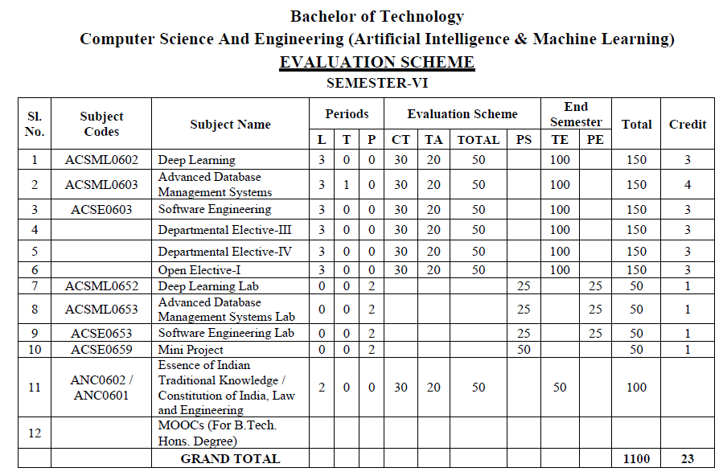
Evaluation Scheme

Slide 8
Syllabus
UNIT-I | BASIC DATA ANALYSIS USING PYTHON/R | 8 Hours
Pandas data structures Series and Data Frame, Data wrangling using pandas, Statistics with Pandas, Mathematical Computing Using NumPy, Data visualization with Python Descriptive and Inferential Statistics, Introduction to Model Building, Probability and Hypothesis Testing, Sensitivity Analysis, Regular expression: RE packages.
UNIT-II | R GRAPHICAL USER INTERFACES | 8 Hours
Built-in functions, Data Objects-Data Types & Data Structure, Structure of Data Items, Manipulating and Processing Data in R using Dplyr package & Stringr package, Building R Packages, Running and Manipulating Packages, data import and export, attribute and data types, descriptive statistics, exploratory data analysis, Flexdashboard and R-shiny.
UNIT-III | DATA ENGINEERING FOUNDATION | 8 Hours
Connecting to a database (sqlite) using Python, Sending DML and DDL queries and processing the result from a Python Program, Handling error, NOSQL query using MongoDB, MongoDB Compass.

Slide 9
Syllabus
UNIT-IV | INTRODUCTION TO TENSOR FLOW AND AI | 8 hours
Introduction, Using TensorFlow for AI Systems, Up and Running with TensorFlow, Understanding TensorFlow Basics, Convolutional Neural Networks, Working with Text and Sequences, and TensorBoard Visualization, Word Vectors, Advanced RNN, and Embedding Visualization. TensorFlow Abstractions and Simplifications, Queues, Threads, and Reading Data, Distributed TensorFlow, Exporting and Serving Models with TensorFlow.
UNIT-V | DEEP LEARNING WITH KERAS | 8 hours
Introducing Advanced Deep Learning with Keras, Deep Neural Networks, Autoencoders, Generative Adversarial Networks (GANs), Improved GANs, Disentangled Representation GANs, Cross-Domain GANs, Variational Autoencoders (VAEs), Deep Reinforcement Learning, Policy Gradient Methods.

Slide 10
Branch-wise Applications
Data analytics is used in most sectors of businesses. Here are some primary areas where data analytics does its magic:
Data analytics is used in the banking and e-commerce industries to detect fraudulent transactions.
The healthcare sector uses data analytics to improve patient health by detecting diseases before they happen. It is commonly used for cancer detection.
Data analytics finds its usage in inventory management to keep track of different items.
Logistics companies use data analytics to ensure faster delivery of products by optimizing vehicle routes.
Marketing professionals use analytics to reach out to the right customers and perform targeted marketing to increase ROI.
Data analytics can be used for city planning, to build smart cities.

Slide 11
Course Objectives
Demonstrate knowledge of statistical data analysis techniques utilized in business decision making. Apply principles of Data Science to the analysis of business problems. Use data mining software to solve real-world problems. Employ cutting edge tools and technologies to analyze Big Data.

Slide 12
Course Outcomes
After completion of this course students will be able to:
CO1 | Install, Code and Use Python & R Programming Language in R Studio IDE to perform basic tasks on Vectors, Matrices and Data frames.
CO2 | Implement the concept of the R packages.
CO3 | Understand the basic concept of the MongoDB.
CO4 | Understand and apply the concept of the RNN and tensorflow.
CO5 | Understand and evaluate the concept of the keras in deep learning.

Slide 13
Program Outcomes
1. Engineering knowledge:
2. Problem analysis:
3. Design/development of solutions:
4.Conduct investigations of complex problems
5. Modern tool usage
6. The engineer and society
7. Environment and sustainability
8. Ethics:
9. Individual and team work
10. Communication:
11. Project management and finance
12. Life-long learning

Slide 14
CO-PO Mapping
Mapping of Course Outcomes and Program Outcomes:
 | PO1 | PO2 | PO3 | PO4 | PO5 | PO6 | PO7 | PO8 | PO9 | PO10 | PO11 | PO12
CO.1 | 3 | 3 | 3 | 2 | 1 |  |  |  | 2 |  |  | 3
CO.2 | 3 | 3 | 3 | 2 | 1 |  |  |  | 2 |  |  | 3
CO.3 | 3 | 3 | 3 | 2 | 1 |  |  |  | 2 |  |  | 3
CO.4 | 3 | 3 | 3 | 2 | 1 |  |  |  | 2 |  |  | 3
CO.5 | 3 | 3 | 3 | 2 | 1 |  |  |  | 2 |  |  | 3

Slide 15
Program Specific Outcomes
On successful completion of graduation degree the Engineering graduates will be able to:
PSO1: Design innovative intelligent systems for the welfare of the people using machine learning and its applications.
PSO2: Demonstrate ethical, professional and team-oriented skills while providing innovative solutions in Artificial Intelligence and Machine Learning for life-long learning.

Slide 16
CO-PSO Mapping
Mapping of Course Outcomes and Program Specific Outcomes:
 | PSO1 | PSO2
CO.1 | 2 | 3
CO.2 | 2 | 3
CO.3 | 2 | 3
CO.4 | 2 | 3
CO.5 | 2 | 3

Slide 17
Program Educational Objectives
PEO1: Pursue higher education and professional career to excel in the field of Artificial Intelligence and Machine Learning.
PEO2: Lead by example in innovative research and entrepreneurial zeal for 21st century skills.
PEO3: Proactively provide innovative solutions for societal problems to promote life-long learning.

Slide 18

End Semester Question Paper Templates (Offline Pattern/Online Pattern)

Slide 19
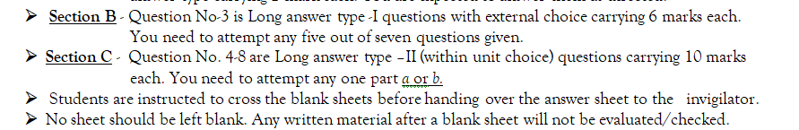
End Semester Question Paper Templates (Offline Pattern/Online Pattern)

Slide 20

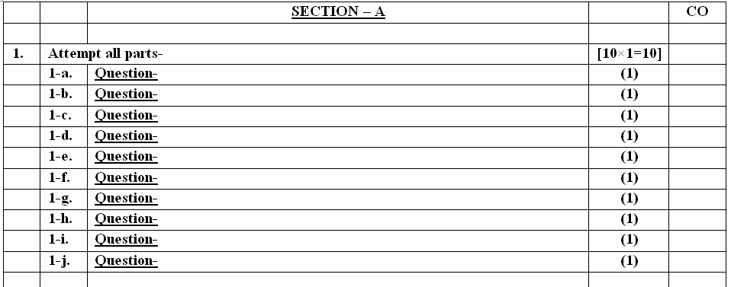
End Semester Question Paper Templates (Offline Pattern/Online Pattern)

Slide 21
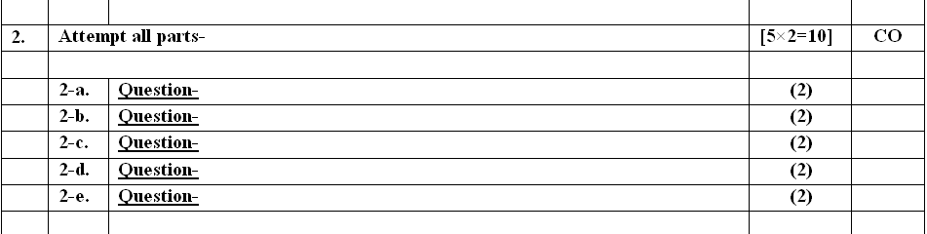
End Semester Question Paper Templates (Offline Pattern/Online Pattern)

Slide 22
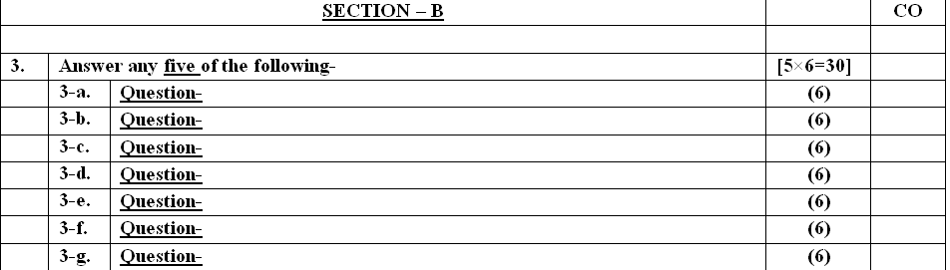
End Semester Question Paper Templates (Offline Pattern/Online Pattern)

Slide 23
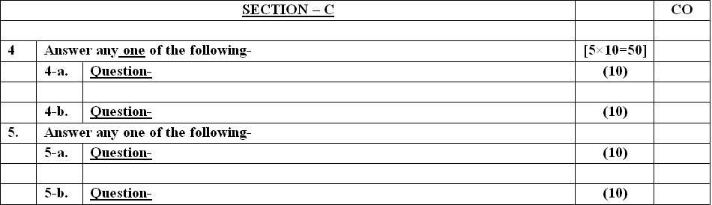
End Semester Question Paper Templates (Offline Pattern/Online Pattern)

Slide 24
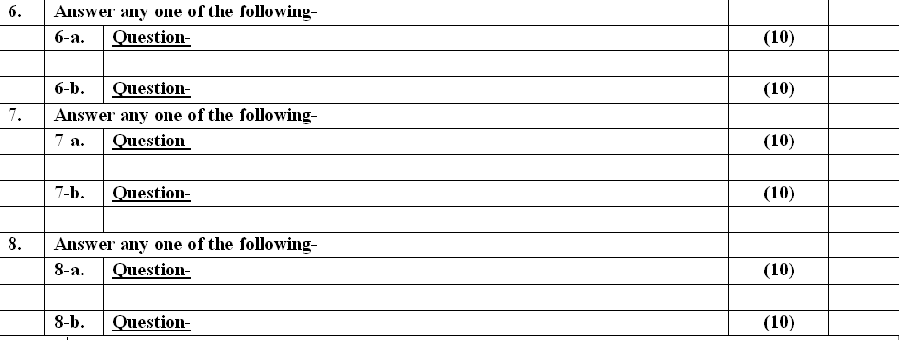
End Semester Question Paper Templates (Offline Pattern/Online Pattern)

Slide 25
Prerequisite/Recap
Students must know computer programming and related programming paradigms

Slide 26
About the Subject with videos
Data is getting generated at a massive rate, by the minute. Organizations, on the other hand, are trying to explore every opportunity to make sense of this data.
This is where Data analytics has become crucial in running a business successfully. It is commonly used in companies to drive profit and business growth
Link:
Unit 1 | https://www.ibm.com/cloud/blog/python-vs-r
Unit 2 | https://www.youtube.com/watch?v=C5R5SdYzQBI
Unit 3 | https://hevodata.com/learn/data-engineering-and-data-engineers/
Unit 4 | https://www.youtube.com/watch?v=IjEZmH7byZQ
Unit 5 | https://www.youtube.com/watch?v=pWp3PhYI-OU

Slide 27
UNIT CONTENT
Built-in functions
Data Objects-Data Types & Data Structure
Structure of Data Items
Manipulating and Processing Data in R using Dplyr package & Stringr package
Building R Packages
Running and Manipulating Packages
data import and export
attribute and data types
descriptive statistics
exploratory data analysis
Flex dashboard and R-shiny.

Slide 28
Unit Objectives
Learn Programming Graphical User Interfaces with R introduces each of the major R packages for GUI programming:
RGtk2, qtbase, Tcl/Tk, and gWidgets.

Slide 29
Topic Objectives
Study how-to guide for developing GUIs within R
The fundamentals for users with limited knowledge of programming within R and other languages
GUI design for specific functions or as learning tools.

Slide 30
What is R?
What is R?
R is an open source programming language and software environment for statistical computing and graphics. It consists of a language together with a run-time environment with a debugger, graphics, access to system functions, and scripting.
R is an implementation of the S programming language, developed by Bell Laboratories, adding lexical scoping semantics. R offers a wide variety of statistical and graphical techniques including time series analysis, linear and nonlinear modelling, classical statistical tests, classification, clustering, and more).
Many statisticians and data scientists use R with the command line.
What is GUI(Graphical User Interface)?

Slide 31
GUI
What is GUI(Graphical User Interface)?
A graphical user interface (GUI) is an interface through which a user interacts with electronic devices such as computers and smartphones through the use of icons, menus and other visual indicators or representations (graphics).
GUIs graphically display information and related user controls, unlike text-based interfaces, where data and commands are strictly in text. GUI representations are manipulated by a pointing device such as a mouse, trackball, stylus, or by a finger on a touch screen.

Slide 32
Graphical User Interface for R
R Studio | Professional software for R with a code editor, debugging & visualization tools
Rattle | R Analytic Tool To Learn Easily: Data Mining using R
StatET for R | Eclipse based IDE (integrated development environment) for RR
RKWard | Easy to use and easily extensible IDE/GUI
JGR | Universal and unified graphical user interface for R
R Commander | A Basic-Statistics GUI for R
Deducer | Intuitive, cross-platform graphical data analysis system

Slide 33
Built-in Functions
R Built-in Functions
The functions which are already created or defined in the programming framework are known as a built-in function. R has a rich set of functions that can be used to perform almost every task for the user. These built-in functions are divided into the following categories based on their functionality.

Slide 34
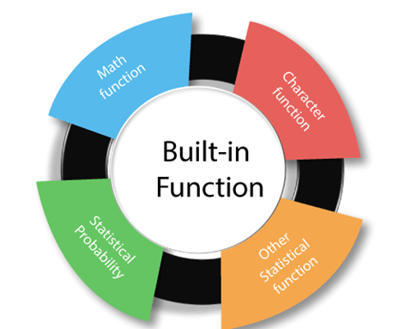
Built-in Functions
These built-in functions are divided into the following categories based on their functionality.
Link: https://www.javatpoint.com/r-built-in-functions

Slide 35
Numeric Functions
Function | Description
abs(x) | absolute value
sqrt(x) | square root
ceiling(x) | ceiling(3.475) is 4
floor(x) | floor(3.475) is 3
trunc(x) | trunc(5.99) is 5
round(x, digits=n) | round(3.475, digits=2) is 3.48
signif(x, digits=n) | signif(3.475, digits=2) is 3.5
cos(x), sin(x), tan(x) | also acos(x), cosh(x), acosh(x), etc.
log(x) | natural logarithm
log10(x) | common logarithm
exp(x) | e^x

Slide 36
Character Functions
Function | Description
substr(x, start=n1, stop=n2) | Extract or replace substrings in a character vector. x <- "abcdef" substr(x, 2, 4) is "bcd" substr(x, 2, 4) <- "22222" is "a222ef"
grep(pattern, x , ignore.case=FALSE, fixed=FALSE) | Search for pattern in x. If fixed =FALSE then pattern is a regular expression. If fixed=TRUE then pattern is a text string. Returns matching indices. grep("A", c("b","A","c"), fixed=TRUE) returns 2
sub(pattern, replacement, x, ignore.case =FALSE, fixed=FALSE) | Find pattern in x and replace with replacement text. If fixed=FALSE then pattern is a regular expression. If fixed = T then pattern is a text string. sub("\\s",".","Hello There") returns "Hello.There"

Slide 37
Statistical Probability Functions
The following table describes functions related to probability distributions. For random number generators below, you can use set.seed(1234) or some other integer to create reproducible pseudo-random numbers.
Function | Description
dnorm(x) | normal density function (by default m=0 sd=1) # plot standard normal curve x <- pretty(c(-3,3), 30) y <- dnorm(x) plot(x, y, type='l', xlab="Normal Deviate", ylab="Density", yaxs="i")
pnorm(q) | cumulative normal probability for q (area under the normal curve to the left of q) pnorm(1.96) is 0.975

Slide 38
Other Statistical Functions
Other useful statistical functions are provided in the following table. Each has the option na.rm to strip missing values before calculations. Otherwise the presence of missing values will lead to a missing result. Object can be a numeric vector or data frame.

Slide 39
Other Statistical Functions
Function | Description
mean(x, trim=0, na.rm=FALSE) | mean of object x # trimmed mean, removing any missing values and # 5 percent of highest and lowest scores mx <- mean(x,trim=.05,na.rm=TRUE)
sd(x) | standard deviation of object(x). also look at var(x) for variance and mad(x) for median absolute deviation.
median(x) | median

Slide 40
Other Useful Functions
Function | Description
seq(from , to, by) | generate a sequence indices <- seq(1,10,2) #indices is c(1, 3, 5, 7, 9)
rep(x, ntimes) | repeat x n times y <- rep(1:3, 2) # y is c(1, 2, 3, 1, 2, 3)
cut(x, n) | divide continuous variable in factor with n levels y <- cut(x, 5)

Slide 41
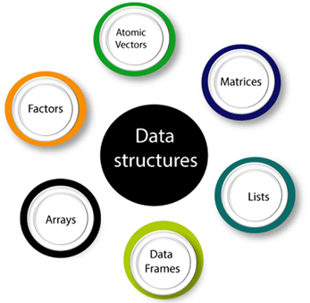
Data Structures in R
Data structures are known to make data accessing and operations easier. They are also selected or designed to be used with different algorithms. In some scenarios, it has been observed that the algorithm’s base operations have closely adhered to the design of the data structures.
Vectors
Lists
Dataframes
Matrices
Arrays
Factors
Data Structures in R

Slide 43
What are Data Structures in R Programming?
A data structure is essentially a way to organize data in a system to facilitate effective usage of the same. The whole idea is to reduce the complexities of space and time in various tasks.
While using a programming language, different variables are essential to store different data. These variables are reserved in a memory location for storing values. Once a variable is created, some area in the memory is reserved.
Data structures are the objects that are manipulated regularly in R. They are used to store data in an organized fashion to make data manipulation and other data operations more efficient. R has many data structures. The following section will discuss them in detail.

Slide 44
Vectors
Vector is one of the basic data structures in R.
It is homogenous, which means that it only contains elements of the same data type.
Vectors are one-dimensional data structures.
A vector is an ordered collection of basic data types of a given length.
Data types can be numeric, integer, character, complex, or logical.
Vectors are created by using the c() function.
Coercion takes place in a vector, from bottom to top, if the elements passed are of different data types, from logical to integer to double to character.

Slide 45
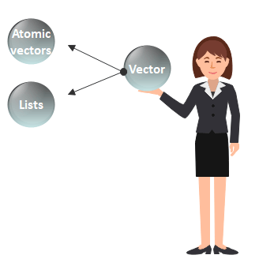
Vectors
Type of Vector

Slide 46
Vector & ways of creating it
Collection of Same Data Type Elements
c() is used to create vector in R
c() function returns a one-dimensional array or simply vector.
The c() function is a generic function which combines its argument.
Way of creating vector
1) Using the colon(:) operator
2) Using the seq() function

Slide 47
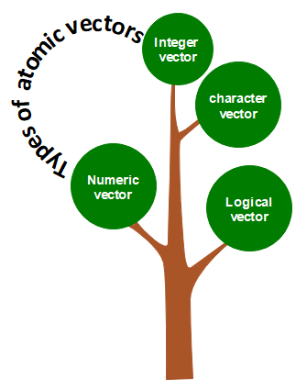
Atomic vectors in R
Numeric vector
The decimal values are known as numeric data types in R.
A vector which contains numeric elements is known as a numeric vector.
Integer vector
A non-fraction numeric value is known as integer data.
This integer data is represented by "Int."
The Int size is 2 bytes and long Int size of 4 bytes.
There is two way to assign an integer value to a variable, i.e., by using as.integer() function and
appending of L to the value.

Slide 48
Atomic vectors in R
Logical vector
The logical data types have only two values i.e., True or False.
These values are based on which condition is satisfied. A vector which contains Boolean values is known as the logical vector.
Character vector
A character is held as a one-byte integer in memory.
In R, there are two different ways to create a character data type value, i.e., using
as.character() function and
by typing string between double quotes("") or single quotes('').
A vector which contains character elements is known as an integer vector.

Slide 49
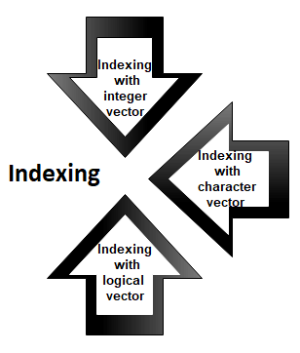
Accessing elements of vectors

Slide 50
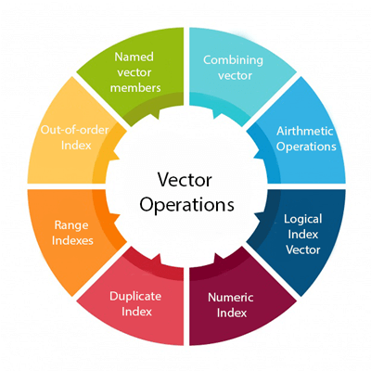
Vector Operation

Slide 51
Vectors
The typeof() function is used to check the data type of the vector, and the class() function is used to check the class of the vector.
To delete a vector, you simply have to do the following:
Vec1 <- c(44, 25, 64, 96, 30)
Vec2 <- c(1, FALSE, 9.8, "hello world")
typeof(Vec1)
typeof(Vec2)
Output:
[1] "double"
[1] "character“
Vec1 <- NULL
Vec2 <- NULL

Slide 52
Methods to Access Vector Elements
Vectors can be accessed in the following ways:
Elements of a vector can be accessed by using their respective indexes. [ ] brackets are used to specify indexes of the elements to be accessed.
For example
Output:
x<c("Jan","Feb","March","Apr","May","June","July")
y <- x[c(3,2,7)]
print(y)
[1] "March" "Feb" "July"

Slide 53
Methods to Access Vector Elements
Logical indexing, negative indexing, and 0/1 can also be used to access the elements of a vector.
For example:
x <- c("Jan","Feb","March","Apr","May","June","July“)
y <- x[c(TRUE,FALSE,TRUE,FALSE,FALSE,TRUE,TRUE)]
z <- x[c(-3,-7)]
c <- x[c(0,0,0,1,0,0,1)]
print(y)
print(z)
print(c)
Output:
[1] "Jan" "March" "June" "July"(All TRUE values are printed)
[1] "Jan" "Feb" "Apr" "May" "June"(All corresponding values for negative indexes are dropped)
[1] "Jan" "Jan"(All corresponding values are printed)

Slide 54
List
A list is a generic object consisting of an ordered collection of objects.
Lists are heterogeneous data structures.
These are also one-dimensional data structures.
A list can be a list of vectors, list of matrices, a list of characters and a list of functions and so on.

Slide 55
Lists
A list is a non-homogeneous data structure, which implies that it can contain elements of different data types. It accepts numbers, characters, lists, and even matrices and functions inside it. It is created by using the list() function.
For example:
Output:
list1<- list("Sam", "Green", c(8,2,67), TRUE, 51.99, 11.78,FALSE)
print(list1)
[[1]] [1] "Sam" [[2]] [1] "Green" [[3]] [1] 8 2 67 [[4]] [1] TRUE [[5]] [1] 51.99 [[6]] [1] 11.78 [7]] [1] FALSE

Slide 56
Matrices
Matrix is a two-dimensional data structure that is homogenous, meaning that it only accepts elements of the same data type. Coercion takes place if elements of different data types are passed. It is created by using the matrix() function.

Slide 57
Dataframes
Dataframes are generic data objects of R which are used to store the tabular data.
They are two-dimensional, heterogeneous data structures.
These are lists of vectors of equal lengths.
A data-frame must have column names and every row should have a unique name.
Each column must have the identical number of items.
Each item in a single column must be of the same data type.
Different columns may have different data types.

Slide 58
Arrays
Arrays are the R data objects which store the data in more than two dimensions.
Arrays are n-dimensional data structures.
For example, if we create an array of dimensions (2, 3, 3) then it creates 3 rectangular matrices each with 2 rows and 3 columns.
They are homogeneous data structures.
array_name <- array(data, dim= (row_size, column_size, matrices, dim_names))

Slide 59
Factor
Factors are used in data analysis for statistical modeling.
They are used to categorize unique values in columns, such as “Male”, “Female”, “TRUE”, “FALSE”, etc., and store them as levels.
They can store both strings and integers.
They are useful in columns that have a limited number of unique values.
To create a factor in R you need to use the function called factor(). The argument to this factor() is the vector.

Slide 60
Data frame
Data frame is a two-dimensional array-like structure that also resembles a table, in which each column contains values of one variable and each row contains one set of values from each column.
A data frame has the following characteristics:
The column names of a data frame should not be empty.
The row names of a data frame should be unique.
The data stored in a data frame can be a numeric, factor, or character type.
Each column should contain the same number of data items.

Slide 61
Data Frame data types
Pandas Type | Native Python Type | Description
object | string | The most general dtype. Will be assigned to your column if column has mixed types (numbers and strings).
int64 | int | Numeric characters. 64 refers to the memory allocated to hold this character.
float64 | float | Numeric characters with decimals. If a column contains numbers and NaNs(see below), pandas will default to float64, in case your missing value has a decimal.
datetime64, timedelta[ns] | N/A (but see the datetime module in Python’s standard library) | Values meant to hold time data. Look into these for time series experiments.

Slide 62
Data Frame data types
In [4]:
#Check a particular column type
df['salary'].dtype
Out[4]: dtype('int64')
In [5]:
#Check types for all the columns
df.dtypes
Out[4]:
object
object
int64
int64
object
int64
rank
discipline
phd
service
sex
salary
dtype: object

Slide 63
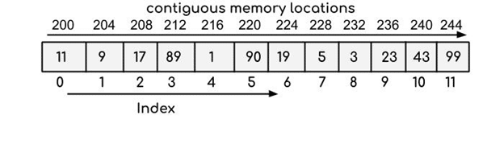
Arrays
Arrays refer to the type of data structure that is used to store multiple items of a similar type together. This leads to a collection of items that are stored at contiguous memory locations. This memory location is denoted by the array name. The position of an element can be calculated simply by adding an offset to its base value.
For example:

Slide 64
Manipulating and Processing Data in R using Dplyr package & Stringr package

Slide 65
Data Manipulation
Data manipulation involves modifying data to make it easier to read and to be more organized. We manipulate data for analysis and visualization. It is also used with the term ‘data exploration’ which involves organizing data using available sets of variables.
At times, the data collection process done by machines involves a lot of errors and inaccuracies in reading. Data manipulation is also used to remove these inaccuracies and make data more accurate and precise.

Slide 66
Data Manipulation in R With dplyr Package
There are different ways to perform data manipulation in R, such as using Base R functions like subset(), with(), within(), etc., Packages like data.table, ggplot2, reshape2, readr, etc., and different Machine Learning algorithms.
However, in this tutorial, we are going to use the dplyr package to perform data manipulation in R.
The dplyr package consists of many functions specifically used for data manipulation. These functions process data faster than Base R functions and are known the best for data exploration and transformation, as well.
In dplyr, d stands for data.frame, plyr can be read as pliers, which is referred to as a tool to manipulate data frame
dplyr library is used to manupulate data in R
first step is to install package dplyr
install.packages(“dplyr”)
Second step to import dplyr
library(“dplyr”)

Slide 67
Data Manipulation functin in R With dplyr Package
filter() : Produces a subset of a Data Frame.
distinct() : Removes duplicate rows in a Data Frame
arrange() : Reorder the rows of a Data Frame
select() : Produces data in required columns of a Data Frame
rename() : Renames the variable names
mutate() : Creates new variables without dropping old ones.
transmute() : Creates new variables by dropping the old.
summarize() : Gives summarized data like Average, Sum, etc.

Slide 68
filter() functin in R With dplyr Package
It is used to produce the subset of the data that satisfies the condition specified in the filter() method.
In the condition, we can use conditional operators, logical operators, NA values, range operators etc. to filter out data.
Syntax of filter() function is given below-
filter(dataframeName, condition)

Slide 69
distinct() functin in R With dplyr Package
The distinct() method removes duplicate rows from data frame or based on the specified columns.
The syntax of distinct() method is given below-
distinct(dataframeName, col1, col2,.., .keep_all=TRUE)

Slide 70
arrange() functin in R With dplyr Package
In R, the arrange() method is used to order the rows based on a specified column.
The syntax of arrange() method is specified below-
arrange(dataframeName, columnName)

Slide 71
select() functin in R With dplyr Package
The select() method is used to extract the required columns as a table by specifying the required column names in select() method.
The syntax of select() method is mentioned below-
select(dataframeName, col1,col2,…)

Slide 72
rename() functin in R With dplyr Package
The rename() function is used to change the column names.
This can be done by the below syntax-
rename(dataframeName, newName=oldName)

Slide 73
mutate() & transmute() function in R With dplyr Package
These methods are used to create new variables.
The mutate() function creates new variables without dropping the old ones but
transmute() function drops the old variables and creates new variables.
The syntax of both methods is mentioned below-
mutate(dataframeName, newVariable=formula)
transmute(dataframeName, newVariable=formula)

Slide 74
summarize() function in R With dplyr Package
Using the summarize method we can summarize the data in the data frame by using aggregate functions like sum(), mean(), etc.
The syntax of summarize() method is specified below-
summarize(dataframeName, aggregate_function(columnName))

Slide 75
String Manipulation in R with stringr
The stringr package is a popular R package that provides functions and tools for manipulating and processing strings in R.
This package provides a consistent and convenient interface for working with strings, and it offers a wide range of functions for tasks such as searching, matching, replacing, and splitting strings.
The “stringr” package provides us the following families of functions in “stringr” −
Character manipulating functions: Such functions allows us to deal with the characters of a string.
A family of functions to deal with whitespaces.
A family of functions whose operations depend on the locale.
A family of pattern-matching functions to deal with.

Slide 76
String manipulation functions in R
grep() : It is used for pattern matching and replacement
nchar() : It is used count the characters
paste() : It is used to concatenate n number of strings.
sprintf() : This function makes of the formatting commands
substr() : It is the substrings of a character vector.
strsplit() : It is used to split a string
regex() : It represents a character vector where matches are sought.
gregexpr() : this function retrieves the matching substrings.

Slide 77
Importing Data in R
Importing data in R programming means that we can read data from external files, write data to external files, and can access those files from outside the R environment. File formats like CSV, XML, xlsx, JSON, and web data can be imported into the R environment to read the data and perform data analysis, and also the data present in the R environment can be stored in external files in the same file formats.

Slide 78
Importing Data in R
Parameters:
x: a matrix or a data frame to be written.
file: a character specifying the name of the result file.
sep: the field separator string, e.g., sep = “\t” (for tab-separated value).
dec: the string to be used as decimal separator. Default is “.”
row.names: either a logical value indicating whether the row names of x are to be written along with x, or a character vector of row names to be written.
col.names: either a logical value indicating whether the column names of x are to be written along with x, or a character vector of column names to be written.

Slide 79
Exporting Data in R
write.table(): The R base function write.table() can be used to export a data frame or a matrix to a text file.
Syntax:
write.table(x, file, append = FALSE, sep = ” “, dec = “.”, row.names = TRUE, col.names = TRUE)

Slide 80
Exporting Data in R
write_tsv(): This method is also used for to export data to a tab separated (“\t”) values by using the help of readr package.
Syntax: write_tsv(file, path)
Parameters:
file: a data frame to be written
path: the path to the result file

Slide 81
Descriptive Statistics
R provides a wide range of functions for obtaining summary statistics. One method of obtaining descriptive statistics is to use the sapply( ) function with a specified summary statistic.
# get means for variables in data frame mydata # excluding missing values sapply(mydata, mean, na.rm=TRUE)

Slide 82
Descriptive Statistics
Possible functions used in sapply include mean, sd, var, min, max, median, range, and quantile.
There are also numerous R functions designed to provide a range of descriptive statistics at once. For example
# mean,median,25th and 75th quartiles,min,max summary(mydata) # Tukey min,lower-hinge, median,upper-hinge,max fivenum(x)

Slide 83
Basic Descriptive Statistics
df.method() | description
describe | Basic statistics (count, mean, std, min, quantiles, max)
min, max | Minimum and maximum values
mean, median, mode | Arithmetic average, median and mode
var, std | Variance and standard deviation
sem | Standard error of mean
skew | Sample skewness
kurt | kurtosis

Slide 84
Graphics to explore the data
Seaborn package is built on matplotlib but provides high level interface for drawing attractive statistical graphics, similar to ggplot2 library in R. It specifically targets statistical data visualization
To show graphs within Python notebook include inline directive:
In [ ]:
%matplotlib inline

Slide 85
Graphics
Functions | Description
distplot | histogram
barplot | estimate of central tendency for a numeric variable
violinplot | similar to boxplot, also shows the probability density of the data
jointplot | Scatterplot
regplot | Regression plot
pairplot | Pairplot
boxplot | boxplot
swarmplot | categorical scatterplot
factorplot | General categorical plot

Slide 86
Basic statistical Analysis
statsmodel and scikit-learn - both have a number of function for statistical analysis
The first one is mostly used for regular analysis using R style formulas, while scikit-learn is more tailored for Machine Learning.
statsmodels:
linear regressions
ANOVA tests
hypothesis testings
many more ...
scikit-learn:
kmeans
support vector machines
random forests
many more ...
See examples in the Tutorial Notebook

Slide 87
Exploratory Data Analysis in R Programming
Exploratory Data Analysis or EDA is a statistical approach or technique for analyzing data sets in order toExploratory Data Analysis or EDA is a statistical approach or technique for analyzing data sets in order to summarize their important and main characteristics generally by using some visual aids. The EDA approach can be used to gather knowledge about the following aspects of data:
Main characteristics or features of the data.
The variables and their relationships.
Finding out the important variables that can be used in our problem.
summarize their important and main characteristics generally by using some visual aids. The EDA approach can be used to gather knowledge about the following aspects of data:
Main characteristics or features of the data.
The variables and their relationships.
Finding out the important variables that can be used in our problem.

Slide 88
Building of R Package
DESCRIPTION File
The DESCRIPTION file is an essential part of an R package because it contains key metadata for the package that is used by repositories like CRAN and by R itself.
In particular, this file contains the
package name,
the version number,
the author and maintainer contact information,
the license information, as well as any dependencies on other packages.
Finding out the important variables that can be used in our problem.

Slide 89
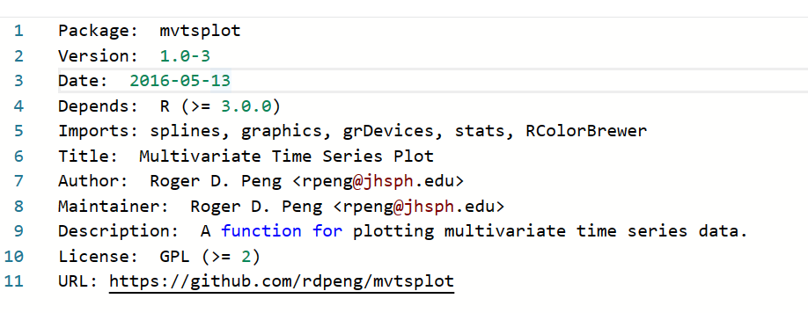
DESCRIPTION file for the mvtsplot package on CRAN

Slide 90
NAMESPACE
The NAMESPACE file specifies the interface to the package that is presented to the user.
This is done via a series of export() statements, which indicate which functions in the package are exported to the user.
Functions that are not exported cannot be called directly by the user (although see below).
In addition to exports, the NAMESPACE file also specifies what functions or packages are imported by the package.
If your package depends on functions from another package, you must import them via the NAMESPACE file.

Slide 91
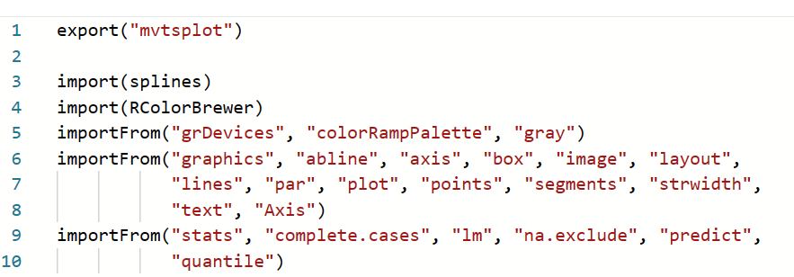
NAMESPACE file for the mvtsplot package
.

Slide 92
Two types of import statements:
.
import(), simply takes a package name as an argument, and the interpretation is that all exported functions from that external package will be accessible to your package
importFrom(), takes a package and a series of function names as arguments. This directive allows you to specify exactly which function you need from an external package. For example, this package imports the colorRampPalette() and gray() functions from the grDevices package.

Slide 93
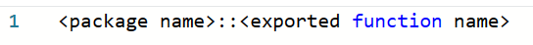
Namespace Function Notation
.
As you start to use many packages in R, the likelihood of two functions having the same name increases.
For example, the commonly used dplyr package has a function named filter(), which is also the name of a function in the stats package.
If one has both packages loaded (a more than likely scenario) how can one specific exactly which filter() function is called?
In R, every function has a full name, which includes the package namespace as part of the name. This format is along the lines of

Slide 94
Namespace Function Notation
For example, the filter() function from the dplyr package can be referenced as dplyr::filter().
It is possible to call functions that are not exported by package by using the namespace notation. The ::: operator can be used for this purpose, as in <package name>:::<unexported function name>.
The use of the ::: operator is not allowed for packages that reside on CRAN.

Slide 95
Loading and Attaching a Package Namespace
Loading:
When package A imports the namespace of package B, package A loads the namespace of package B in order to gain access to the exported functions of package B.
However, when the namespace of package B is loaded, it is only available to package A; it is not placed on the search list and is not visible to the user or to other packages.
Attaching
a package namespace places that namespace on the search list, making it visible to the user and to other packages.
Sometimes this is needed because certain functions need to be made visible to the user and not just to a given package.

Slide 96
Summary
R packages provide a convenient and standardized mechanism for distributing R code to a wide audience.
As part of building an R package you design an interface to a collection of functions that users can access to make use of the functionality you provide.
R packages are directories containing R code, documentation files, package metadata, and export/import information.
Exported functions are functions that are accessible by the user; imported functions are functions in other packages that are used by your package.

Slide 97
The devtools package
devtools is introduced by Hadley Wickham
It includes a variety of functions that facilitate software development in R.
key functions included in devtools

Slide 98
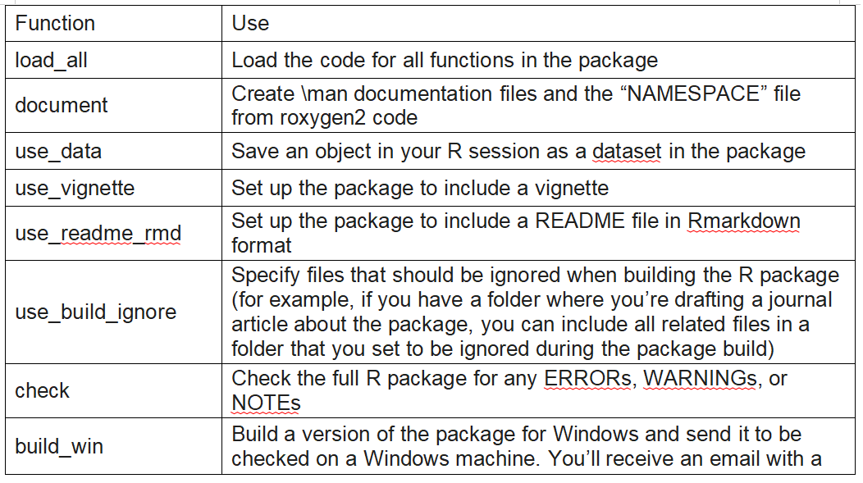
key functions included in devtools
devtools is introduced by Hadley Wickham
It includes a variety of functions that facilitate software development in R.
key functions included in devtools

Slide 99
How to Create Package in R?
How to Create Package in R?

Slide 100
How to Create Package in R?
In R package in RStudio by selecting “File” -> “New Project” -> “New Direction” -> “R Package”.
In addition to starting a package using create or by creating a new project in RStudio, you could also create the package by hand, creating and then filling a directory. However, it’s hard to think of any circumstances where there would be a good reason to do that rather than using some of the more convenient tools offered by devtools and RStudio.
Figure 3.1 gives an example of what the new package directory will look like after you create an initial package structure with create or via the RStudio “New Project” interface. This initial package directory includes an R subdirectory, where you will save R scripts with all code defining R functions for the package. It also includes two files that will store metadata and interface information about your package (DESCRIPTION and NAMESPACE), as well as an R project file (.Rproj extension) that saves some project options for the directory. Finally, the initial package structure includes two files that can be used to exclude some files in the directory from either being followed by git (.gitignore) or included when the package is built (.Rbuildignore). These two files have names that start with a dot, so they may not be listed if you look at the package directory structure in a file manager like “Finder” on Macs. These “dot-files” will, however, be listed in the “Files” tab that shows up in one of the RStudio panes when you open an R project like a package directory, as shown in this figure.

Slide 101
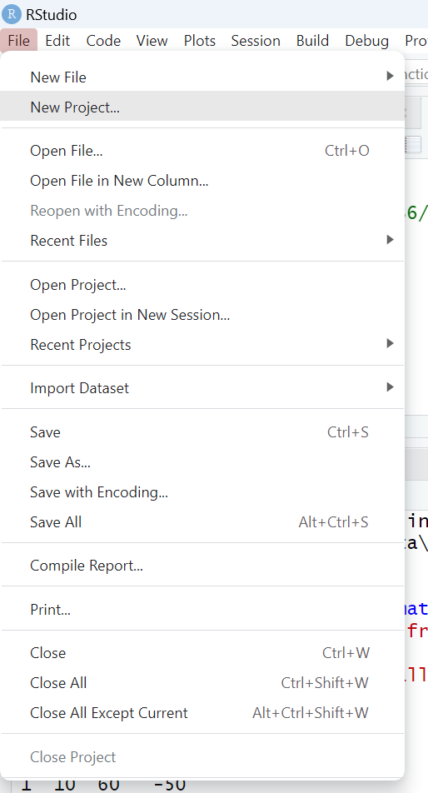
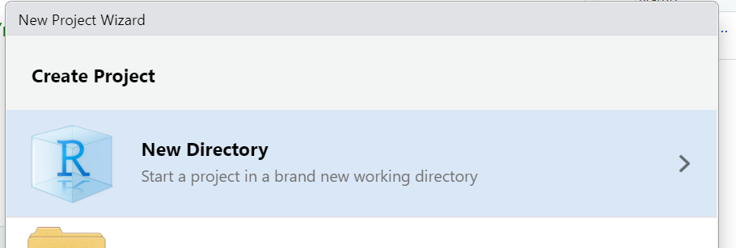
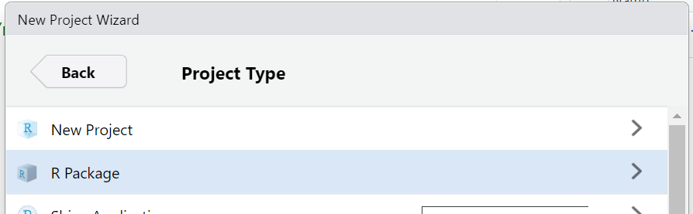

Slide 102
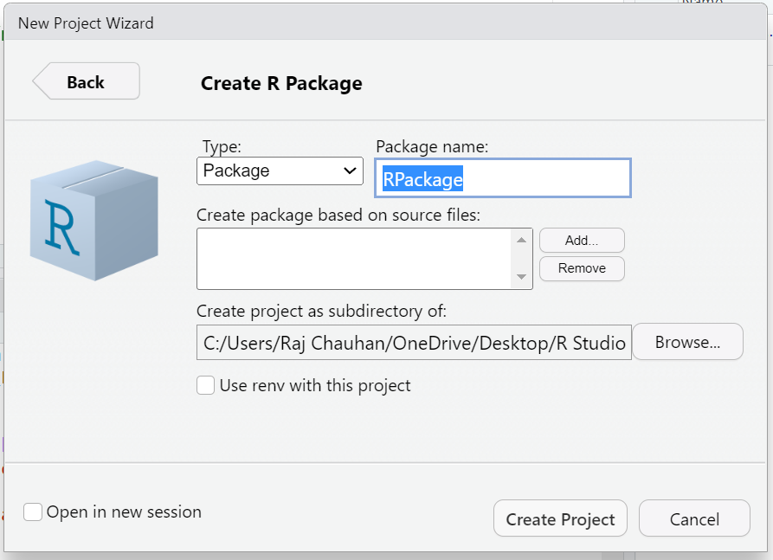

Slide 103
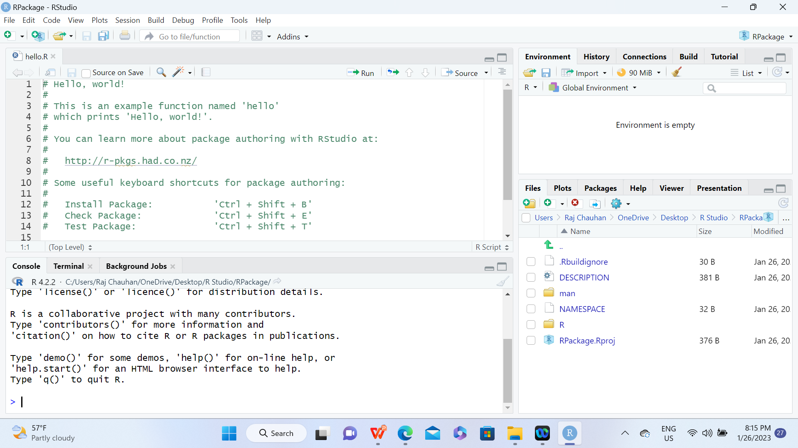

Slide 104
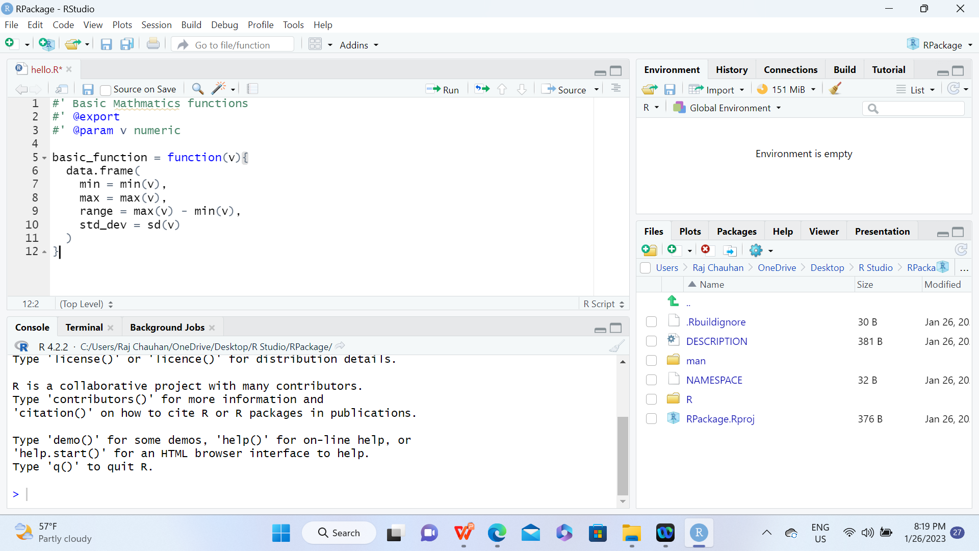

Slide 105
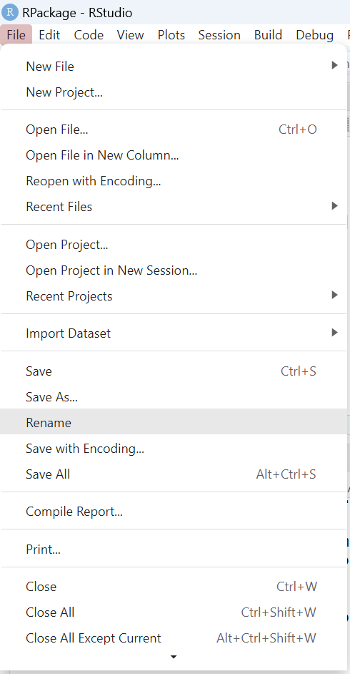
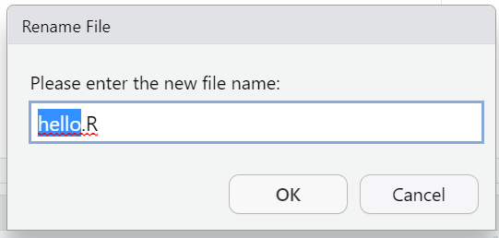
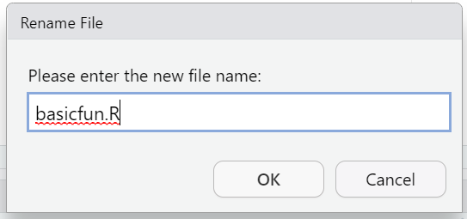

Slide 106

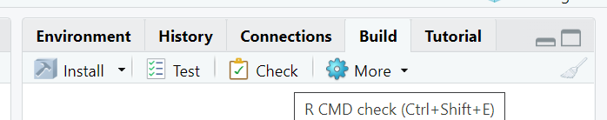

Slide 107
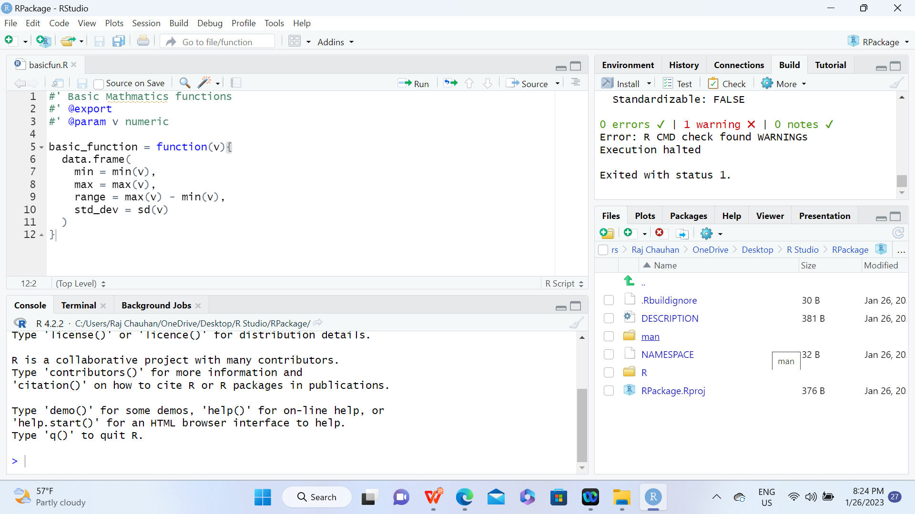
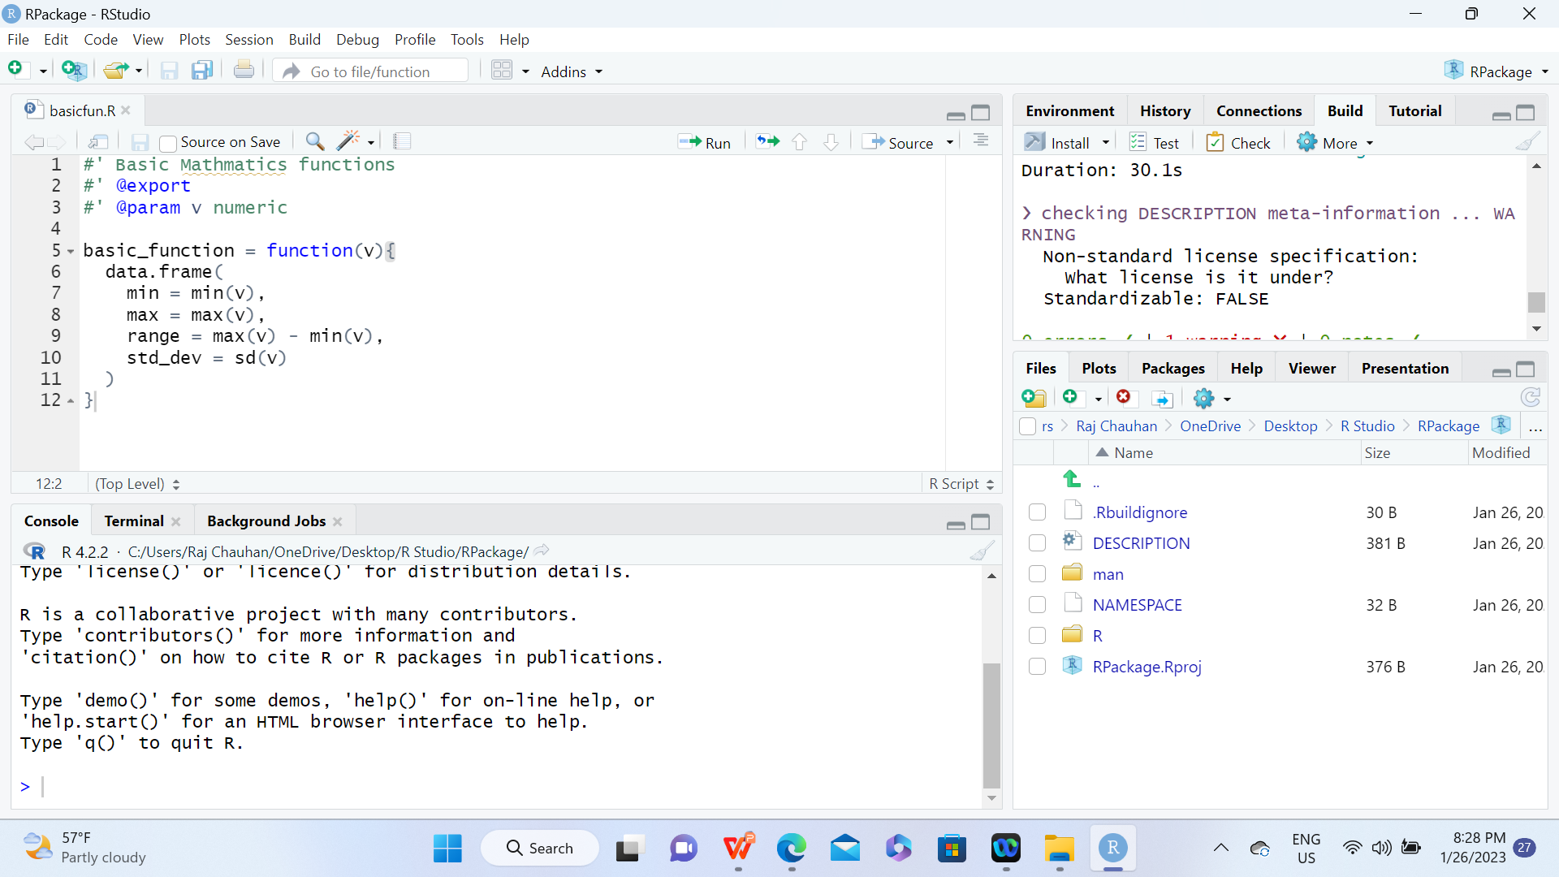

Slide 108
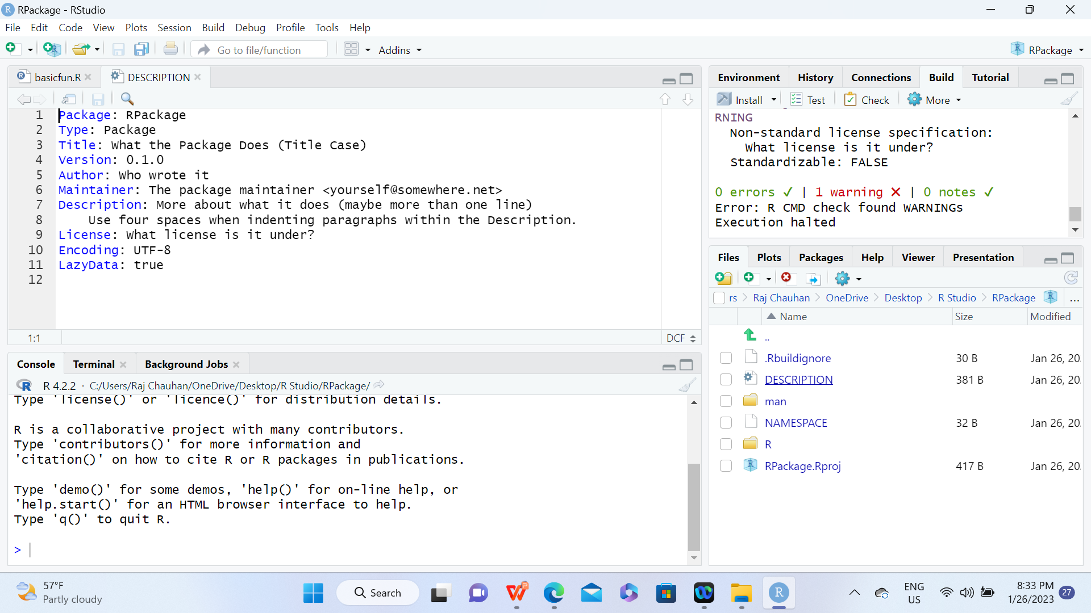

Slide 109


Slide 110
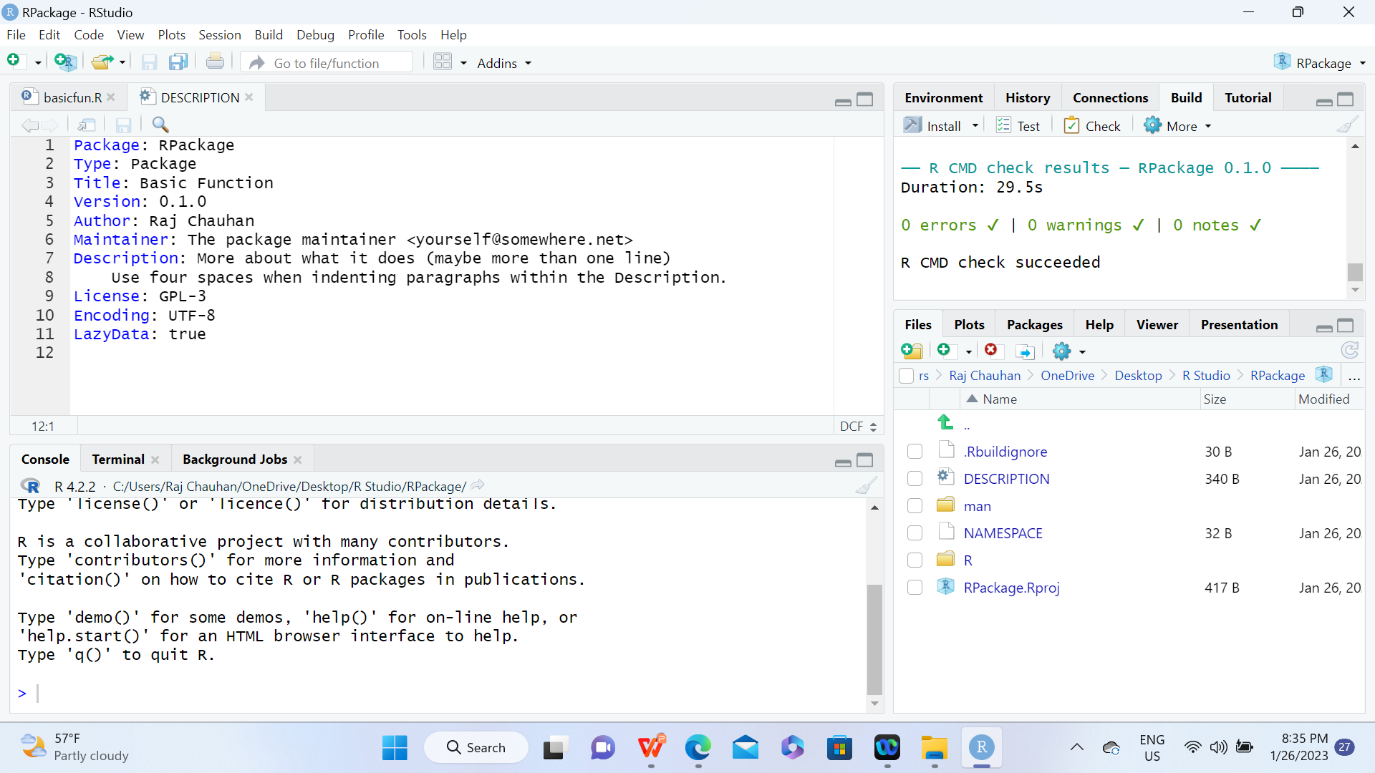

Slide 111
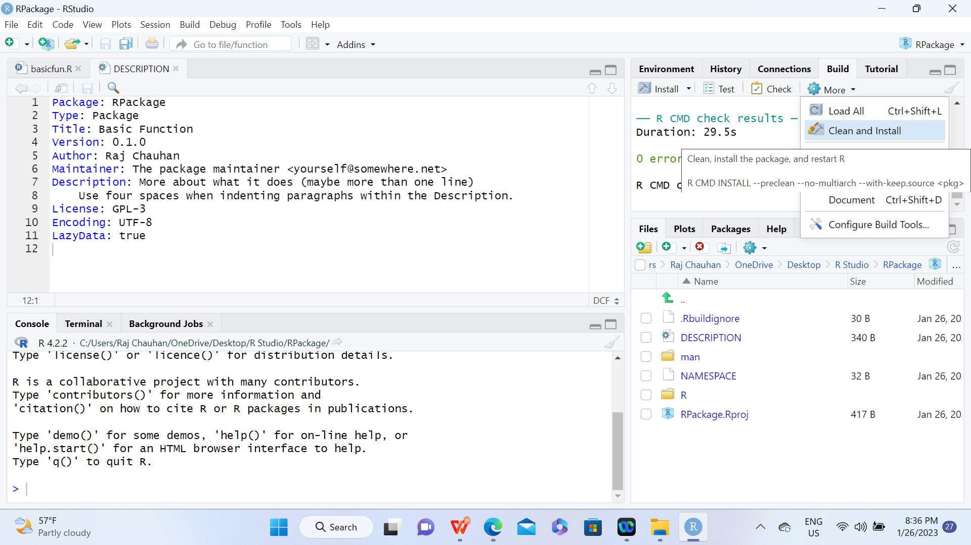

Slide 112
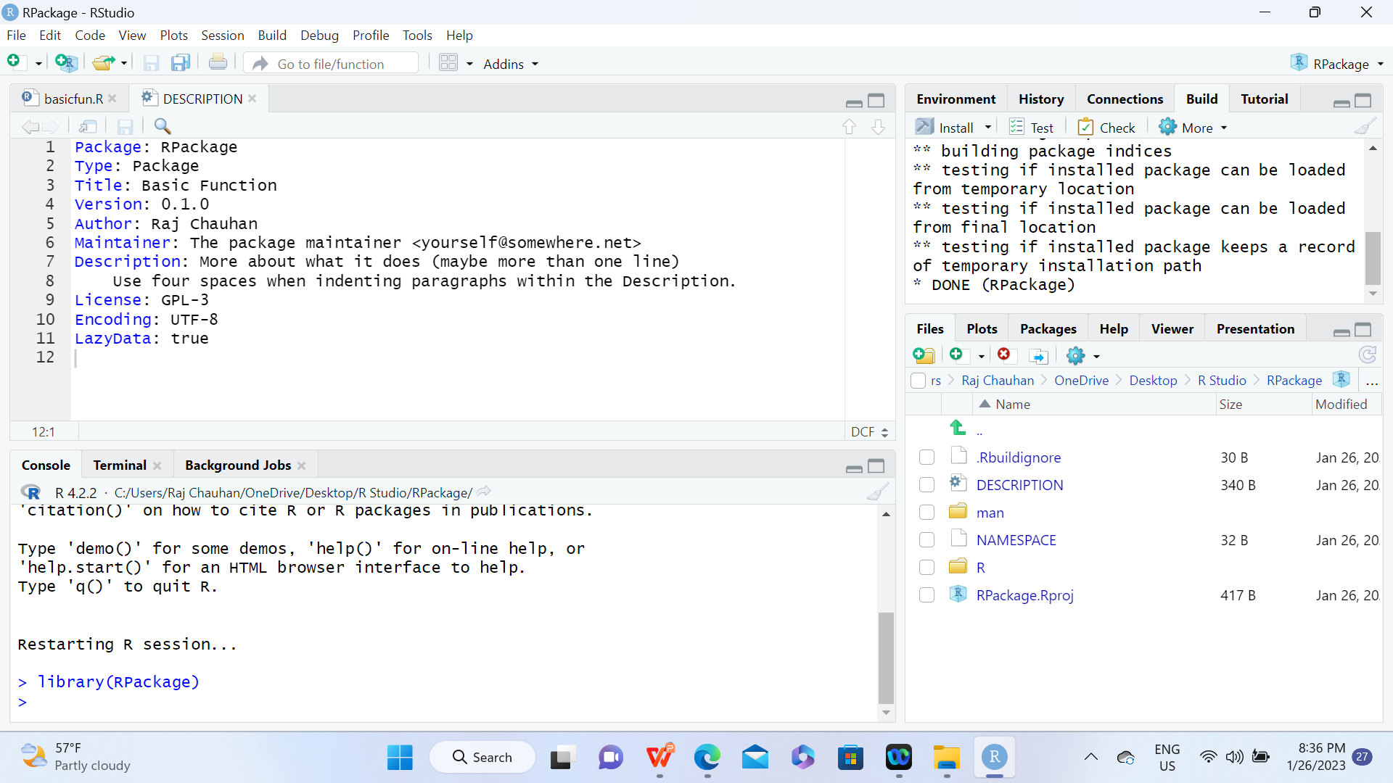

Slide 113
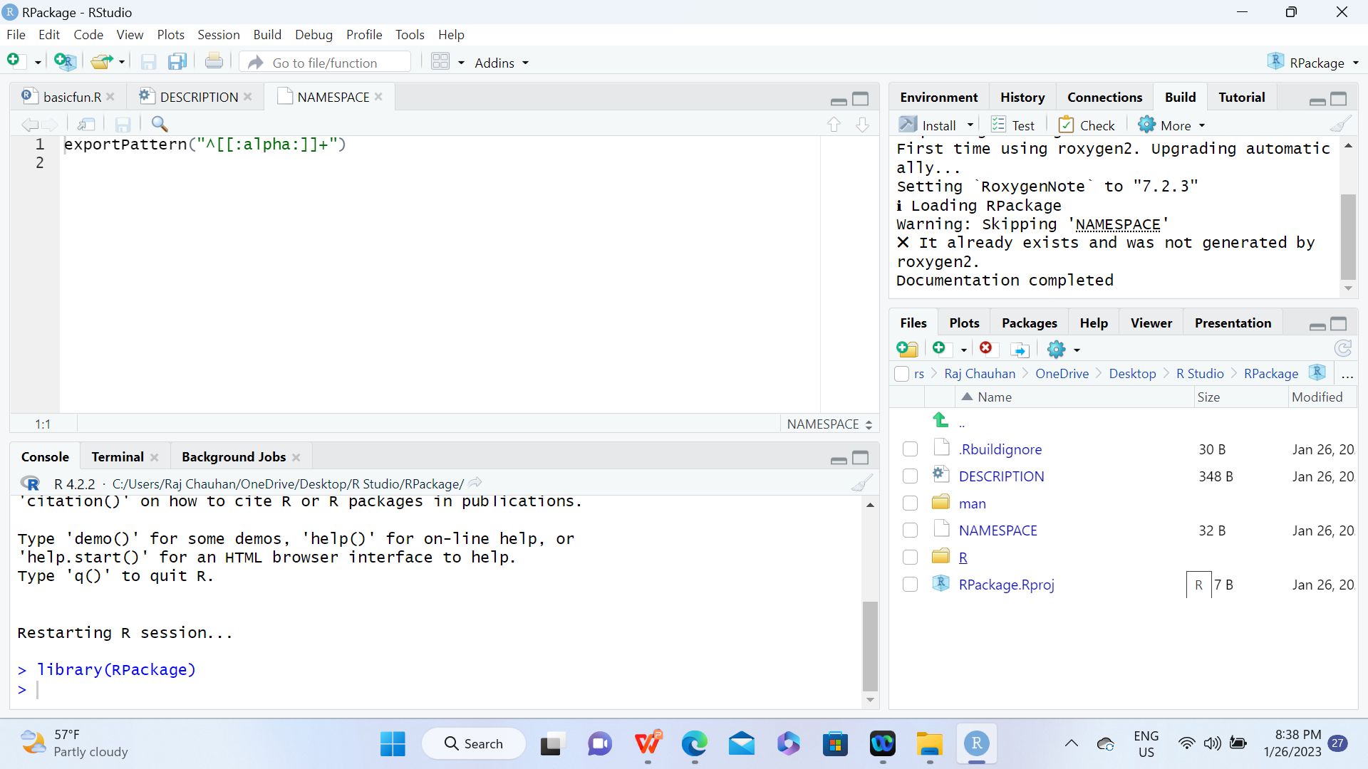

Slide 114


Slide 115
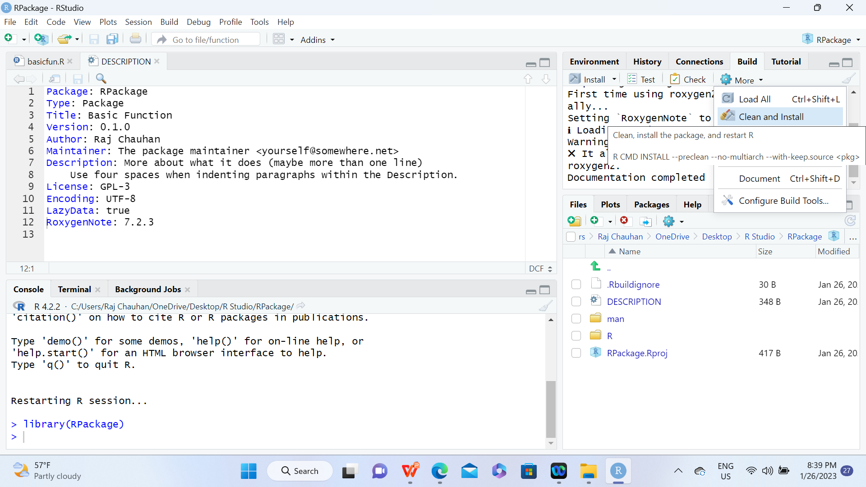

Slide 116
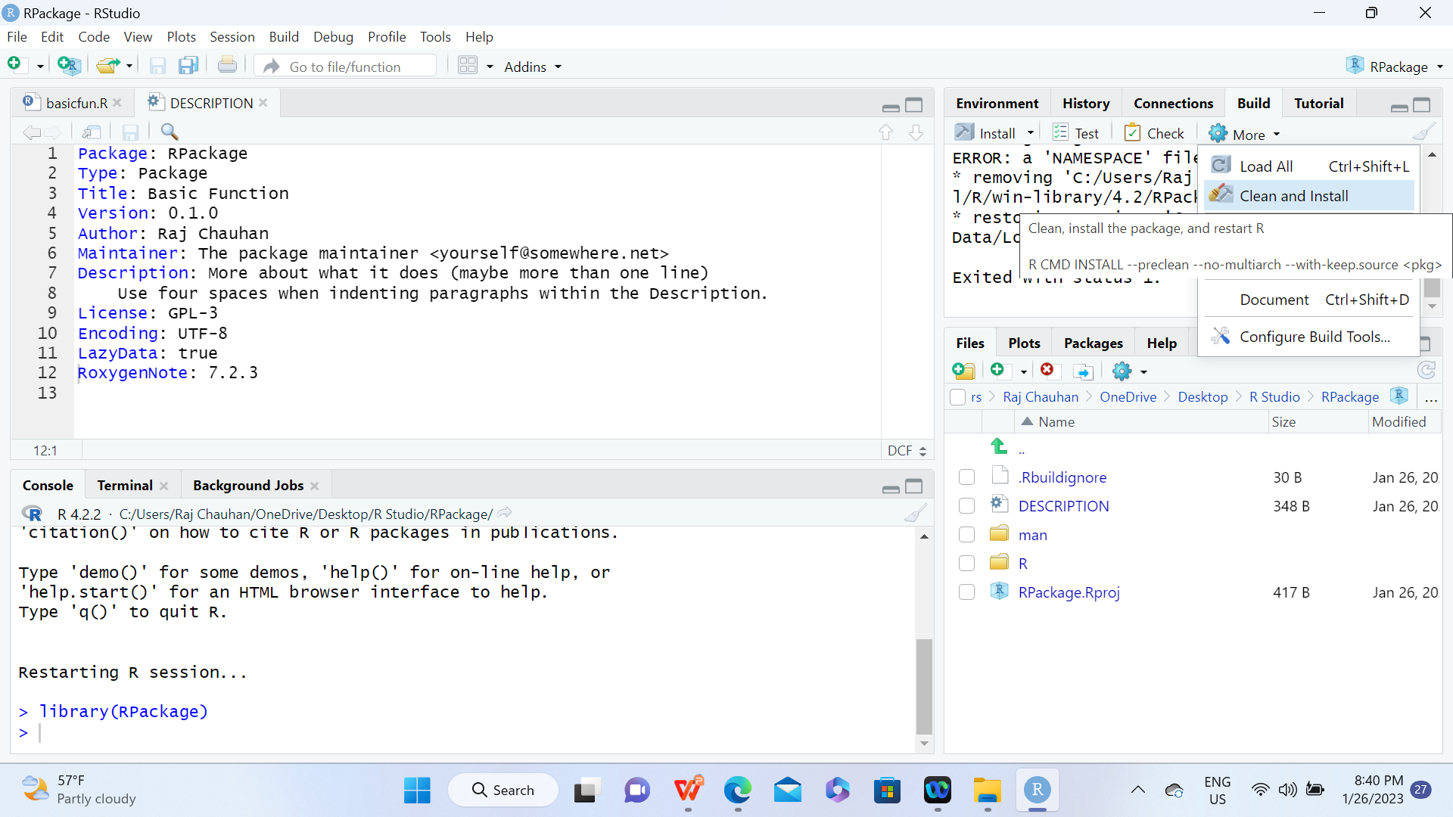

Slide 117
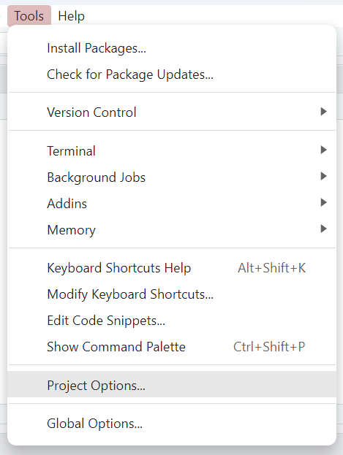

Slide 118
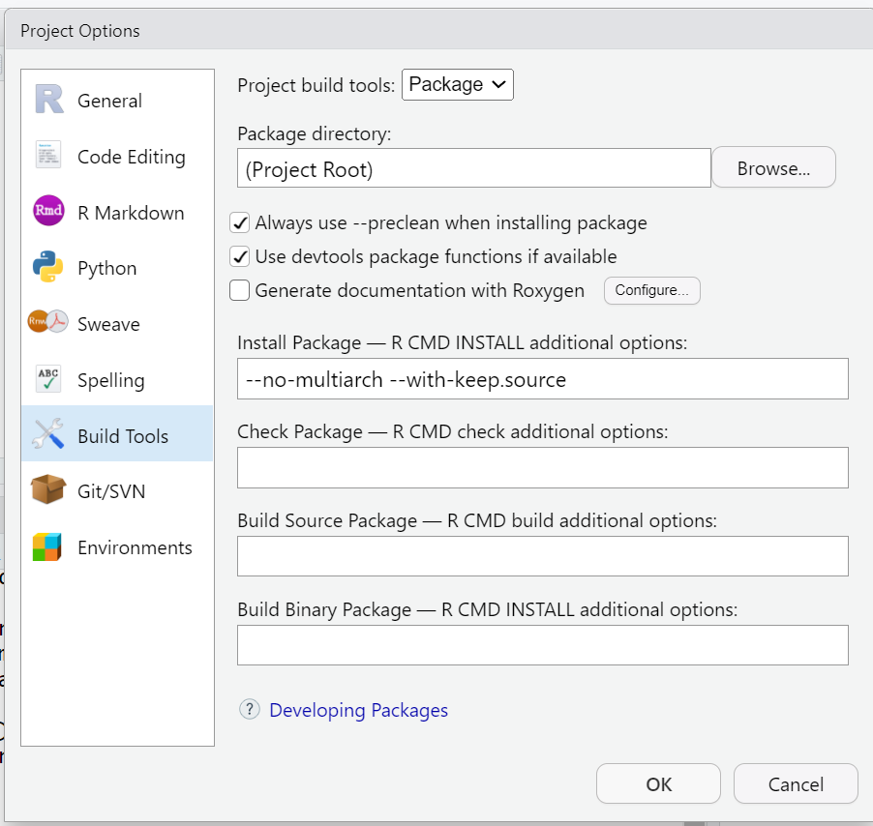

Slide 119
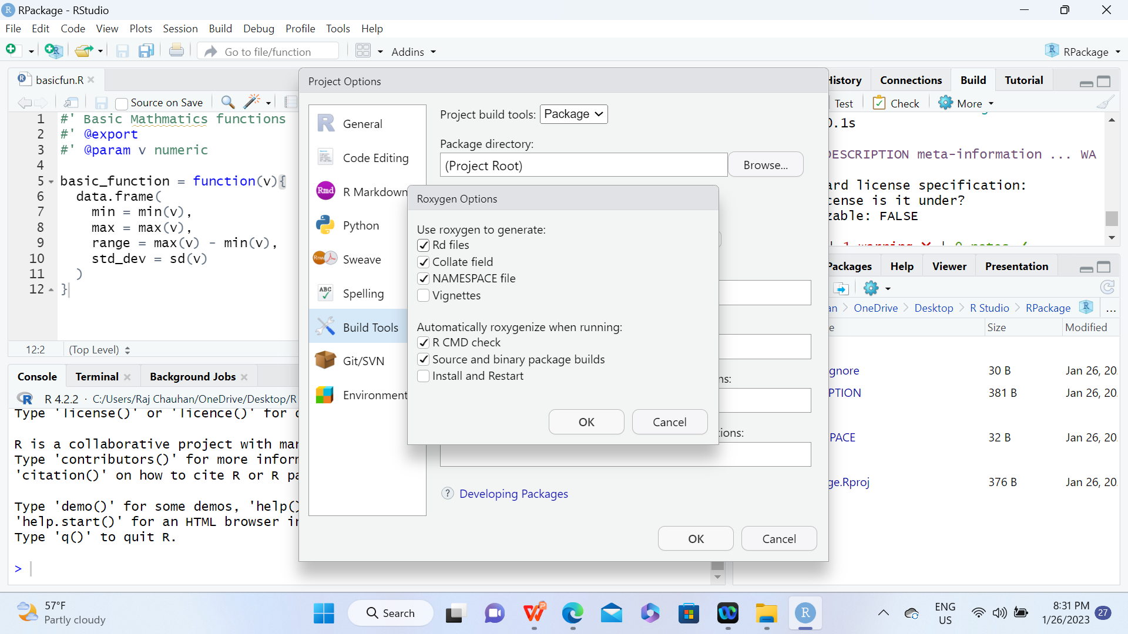

Slide 120
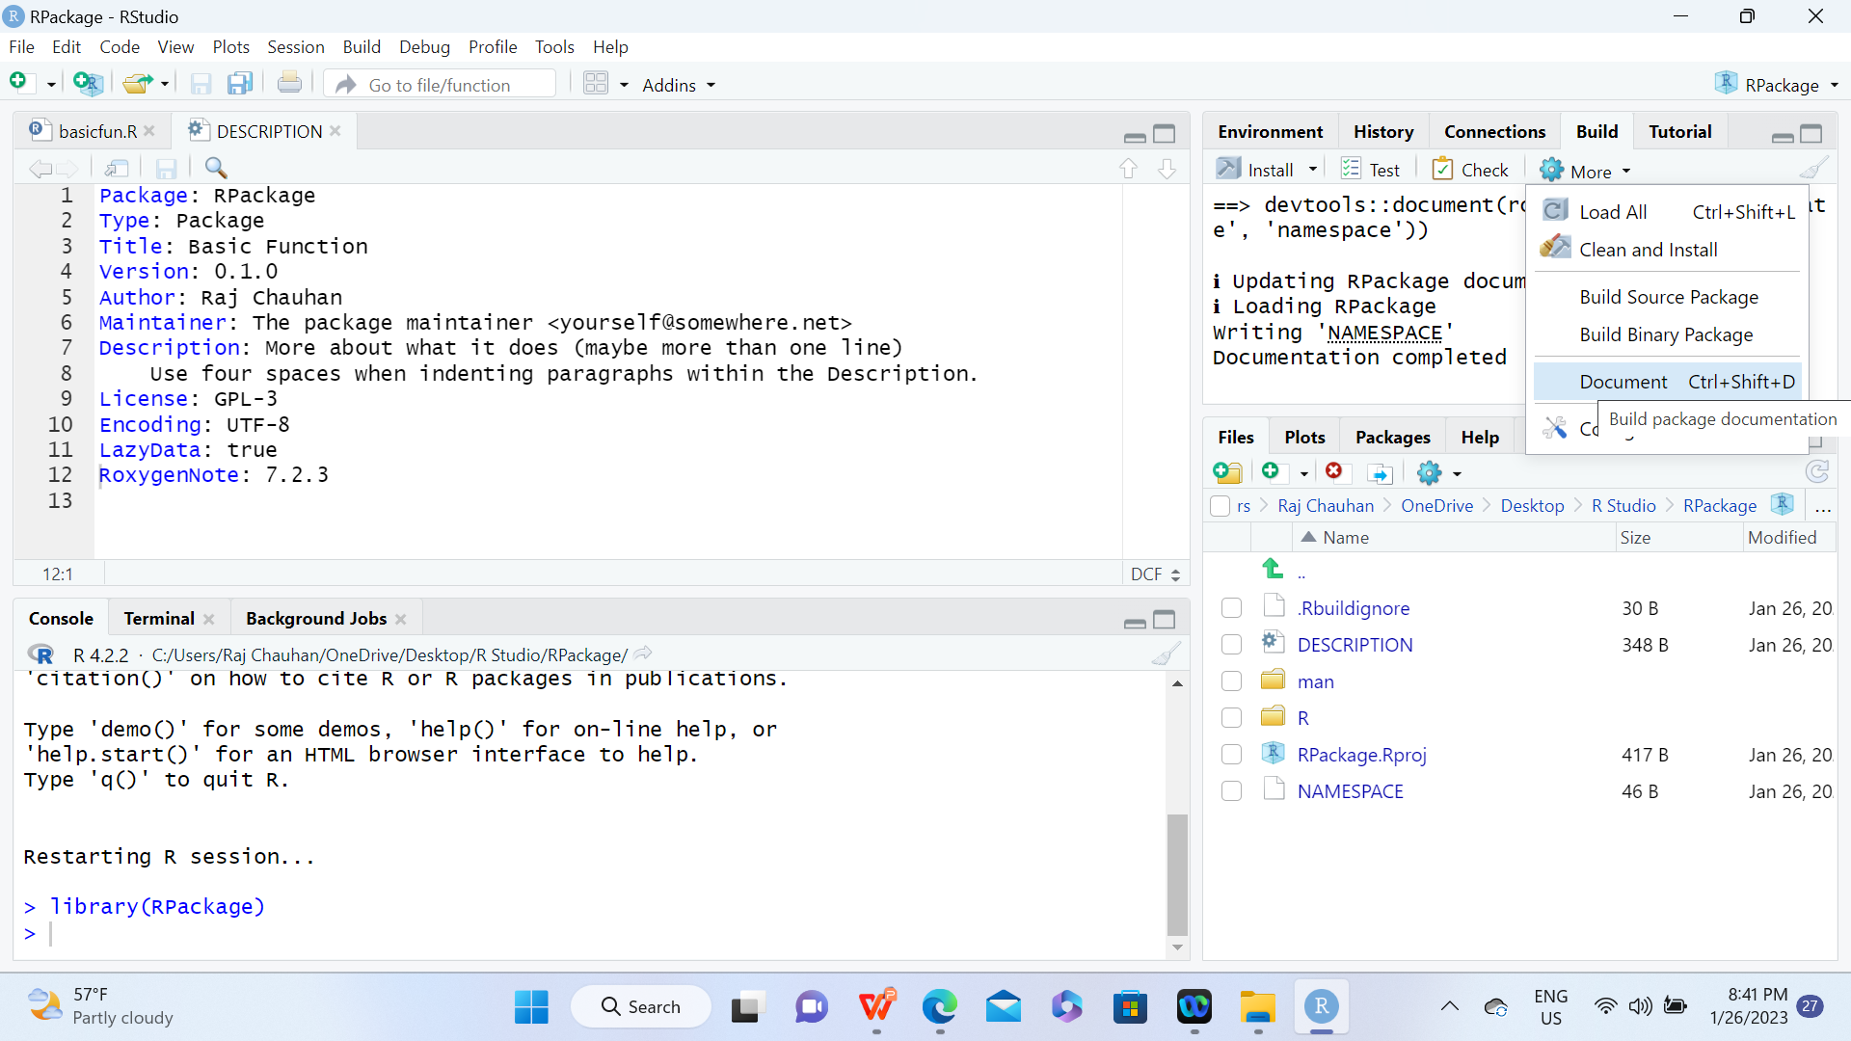

Slide 121
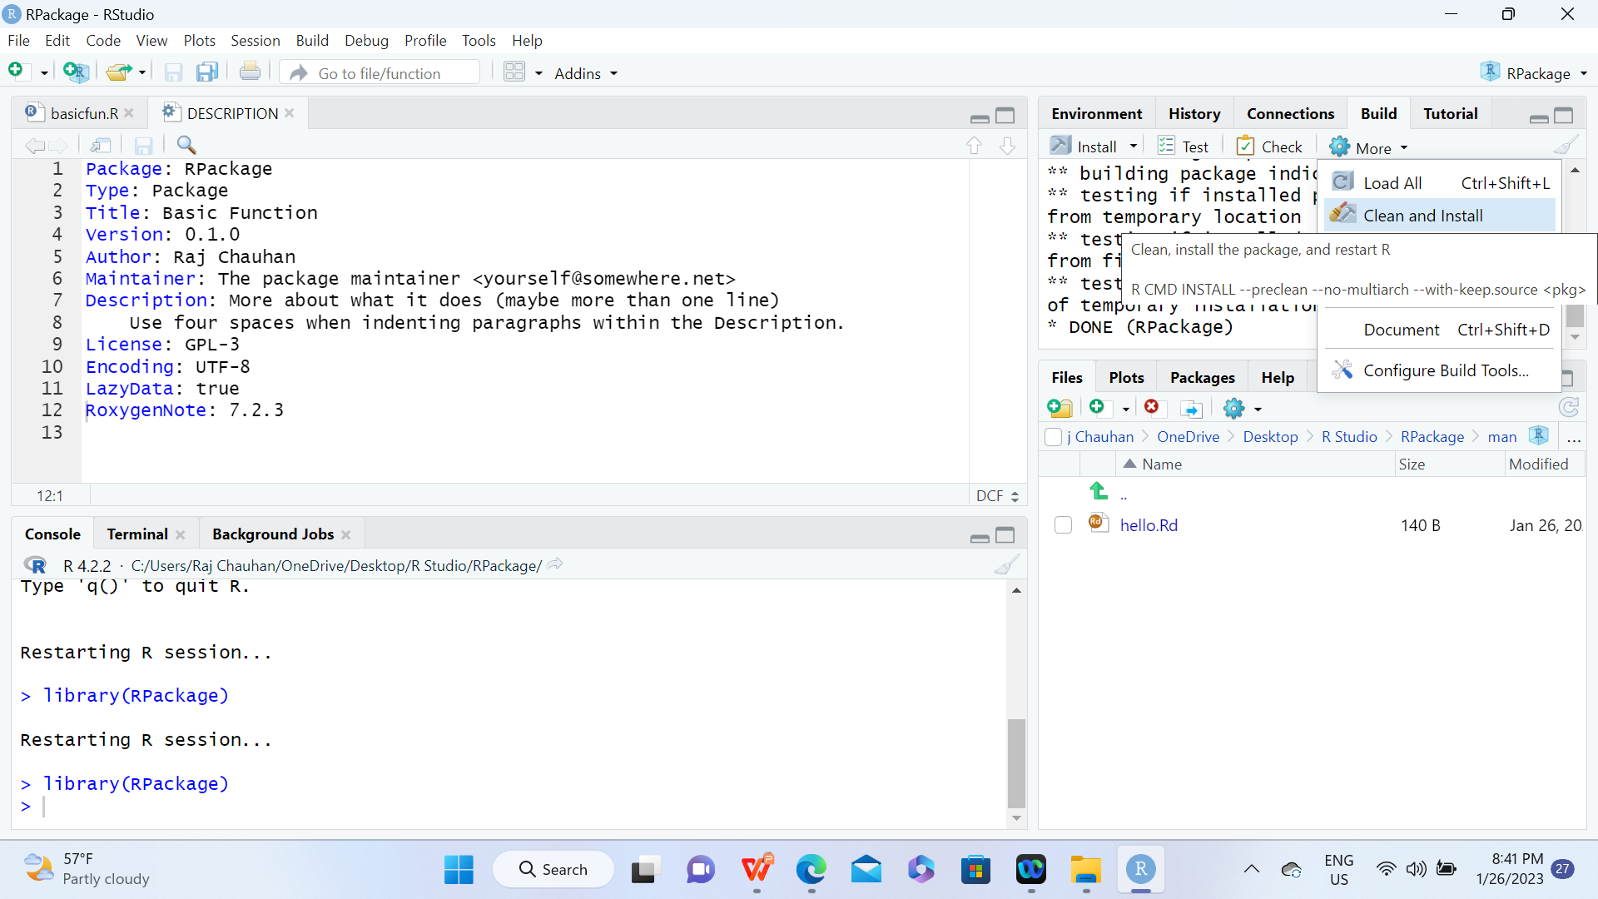

Slide 122
Creating a Package

Slide 123
Flexdashboard and R-shiny
Flexdashboard is an R markdown file, which can be either static or dynamic.By combining flexdashboard with Shiny, you can write dynamic web applications without any knowledge of HTML, CSS, or JavaScript, using only R and R markdown.
Before we start, make sure you have installed the following libraries: shiny, flexdashboard, plotly, dplyr.

Slide 124
DAILY QUIZ
Which of the following is a base package for R language?
util
lang
tools
All of the above
R comes with a ________ to help you optimize your code and improve its performance.
Debugger
Monitor
Profiler
None of the above

Slide 125
Weekly Assignment
What are the different data structures in R? Briefly explain about them.
How can you load a .csv file in R?
What are the different components of grammar of graphics?
What is Rmarkdown? What is the use of it?
How do you install a package in R?

Slide 126
TOPIC LINKS
Suggested video link
https://youtu.be/I4NRCN9DPTI
https://youtu.be/IESCYrdaiVY

Slide 127
MCQ
1. debug() flags a function for ______ mode in R mode.
debug
run
compile
None of the above
2. _____ suspends the execution of a function wherever it is called and puts the function in debug mode
recover()
browser()
Both of the above
3. A matrix is ___dimensionsinal rectangular data set?
5
4
3
2

Slide 128
MCQ
4. The _____ function takes a vector or other objects and splits it into groups determined by a factor or list of factors.
apply()
split()
isplit()
mapply()
5. lapply function takes___ arguments in R language
1
3
4
5

Slide 129
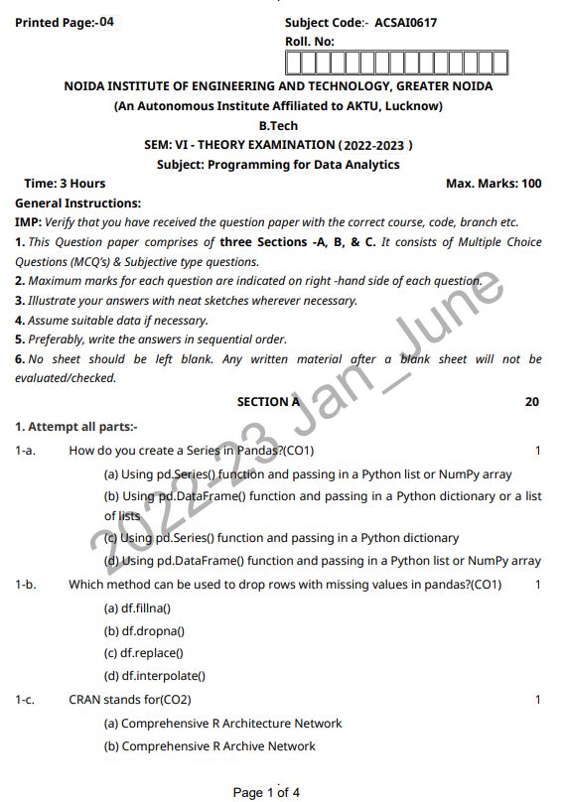
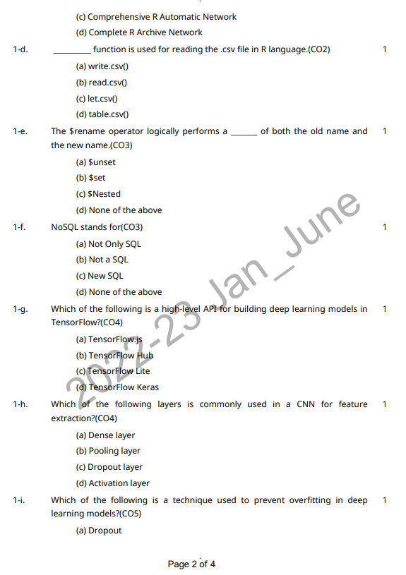
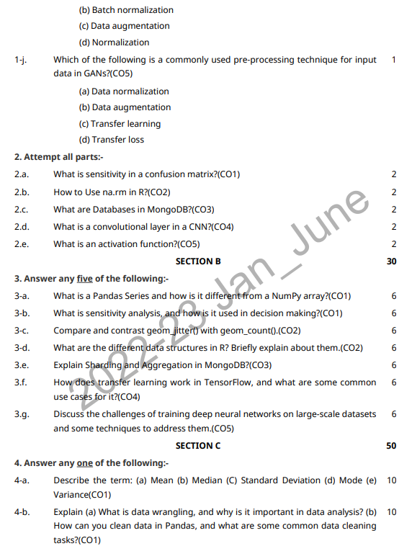
Old University Question Paper

Slide 130
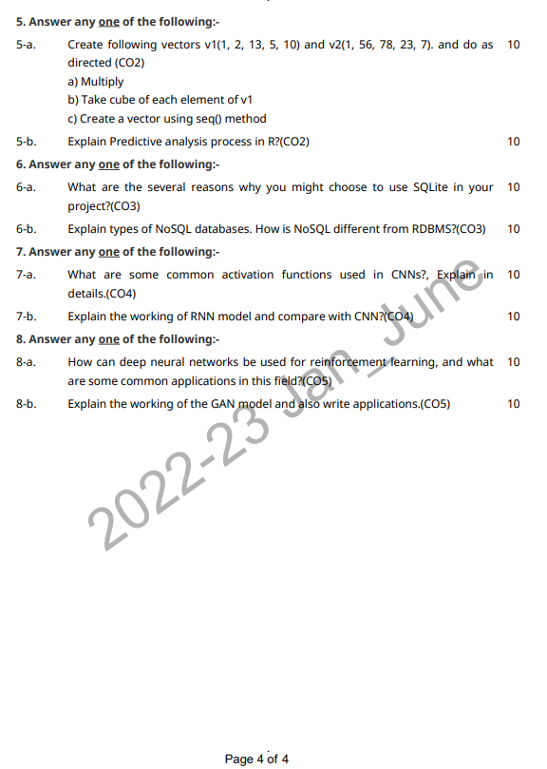
Old University Question Paper
Link to download Paper: https://www.niet.co.in/pdf/previous-years/2022-23/6th-Semester-2022-2023/ACSAI0617.pdf

Slide 131
Expected Questions
Explain the 5 built in functions in R and define data types and data structures used in R.
How the data import and export can be done in R programming?
Write the two commands of the g Dplyr package & Stringr package.
Write the steps of the exploratory data analysis in R.
How we can represent different data structures in R. Explain with an example.
Write a short note on Flexdasboard and R shiny.
What is List in R? Explain creation, accessing and manipulation of List with example in R.
Create a dataframe Student using Vectors with RollNo, Name, Age, Course and Fee attributes in R and write commands to perform following tasks.
a) Rename column name Course with Branch using rename().
b) Show all records of students who is paying more than 50K and enrolled in AIML branch using subset().
c) Add column Hostel_Charge that is 20% of Fee using mutate().
d) Sort all students as per their Fee in Ascending order.<br/>e) Delete records of students who are enrolled in CSBS branch.
Create following vectors v1(1, 2, 13, 5, 10) and v2(1, 56, 78, 23, 7). and do as directed
a) Multiply b) Take cube of each element of v1 c) Change data type of v2 to Integer using both methods d) Create a vector using seq() and colon method
What is Descriptive analysis in R? Explain Descriptive analysis methods in R?
Discuss the steps involve in Exploratory Data Analysis (EDA).
What are the differences between flexdashboard and Shiny?
What is correlation? How would you measure correlation in R?
What are the two ways to convert a numberic data type in integer data type? Using these ways convert vect &lt;- c(12,23,34,56) into integer.
Describe the difference between is.finite(x) and !is.infinite(x).

Slide 132
Recap of Unit
R is ideal for machine learning operations such as regression and classification. It even offers many features and packages for artificial neural network development.
R facilitates quality plotting and graphing. The popular libraries like ggplot2 and plotly advocate for aesthetic and visually appealing graphs that set R apart from other programming languages.

Slide 133
References
Text Books:
(1) Glenn J. Myatt, Making sense of Data: A practical Guide to Exploratory Data Analysis and Data Mining, John Wiley Publishers, 2007.
(2) Learning TensorFlow by Tom Hope, Yehezkel S. Resheff, Itay Lieder O'Reilly Media, Inc.
(3) Advanced Deep Learning with TensorFlow 2 and Keras: Apply DL, GANs, VAEs, deep RL, unsupervised learning, object detection and segmentation, and more, 2nd Edition.
Reference Books:
(4) Boris lublinsky, Kevin t. Smith, Alexey Yakubovich, “Professional Hadoop Solutions”, 1 st Edition, Wrox, 2013.
(5) Chris Eaton, Dirk Deroos et. al., “Understanding Big data”, Indian Edition, McGraw Hill, 2015.
(6) Tom White, “HADOOP: The definitive Guide”, 3 rd Edition, O Reilly, 2012

Slide 134
Thank You

